Slide 1
Impact of COVID-19 on New York City Bike Sharing Program
Start!
Tian Wang (213990353)
Yijian Zhang (218337345)
Jordan Feng (218403204)
Dhrun Lauwers (218070342)
Joyce Otonglo (218420687)
Shaoshi Zhang (217875360)

Slide 2
Table of Contents
01
02
03
Introduction
Problem Statement
Methodology
04
05
06
Findings & Interpretation
Insights & Recommendation
Conclusion

Slide 3
01
Introduction
……...

Slide 4

New York City Bike Share Program in times of Corona

Slide 5
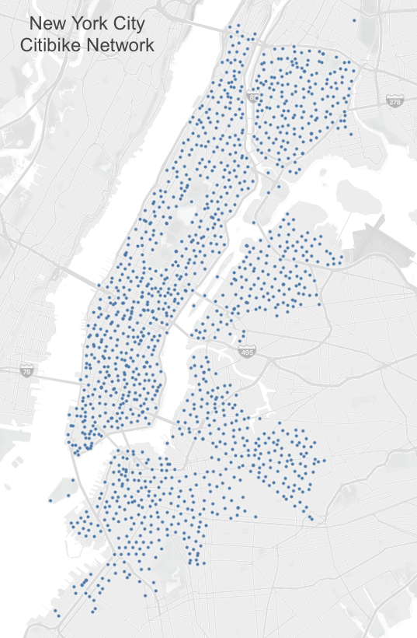
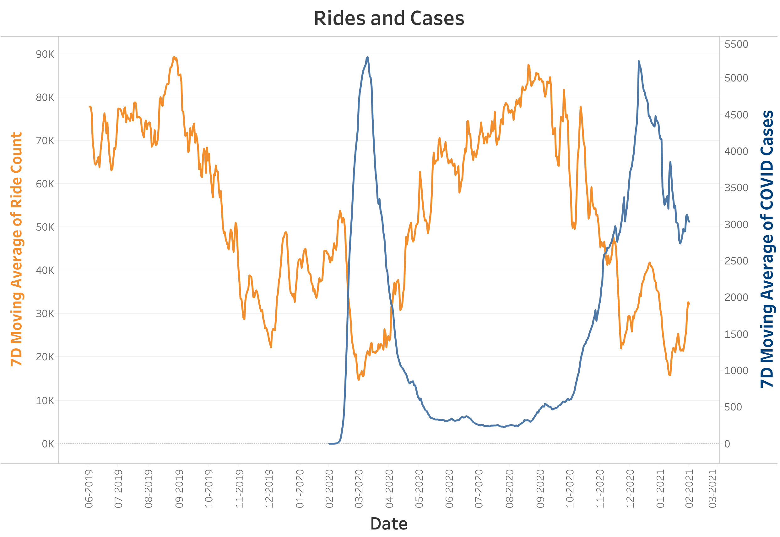
Introduction
Station Network
COVID-19
Notes:
The Citibike network currently contains approximately 1,300 stations, stretching across NYC. The goal of the plan is the double the area serviced and triple the number of bikes in circulation by 2023.
Here we plot the 7-day moving average of daily ride count and the daily cases. From the plot, when the COVID hit the US in March 2020, where the blue line starts, there is a significant drop in rides and an obvious inverse relationship appeared. This relationship suggests that the on-going pandemic is important to the future plans of the Citibike.

Slide 6
02
Problem Statement
……...

Slide 7
A business opportunity in the midst of a crisis and beyond
02
04
01
03
Public Transportation
Change in consumer behaviour
2020 Global Crisis
Bikeshare: bigger and better
Major potential agent of spreading the virus
Revamp the service and grow the business
Covid-19 changed the world
Need for safer means of movement in cities

Slide 8
03
Methodology
……...

Slide 9
Methodology
Data Source
Descriptive Analysis
Citi Bike Trip Histories
Daily Cases, Hospitalizations and Deaths (COVID-19)
4 C's Of Data Cleaning:
Correcting
Completing
Creating
Converting

Slide 10
Methodology
Supervised learning
Unsupervised learning
AI implementation
MLP
RMSE
Correlation Matrix
Feature importance
Elbow method
K-means clustering
Hierarchy clustering
Single linkage
Complete linkage
Cost-benefit analysis
Notes:
Thanks, yijian, After dealing with the issue of datasets that need to be used, our group wants to use supervised learning first-MLP to find whether COVID cases directly impact the number of bike rides and the average duration of trips. For this algorithm, our group would like to change the number of hidden layers and nodes to see whether the RMS increases or decreases. Thus, we can choose appropriate number of nodes and hidden layers to make the prediction. Then, our group make the correlation matrix to define whether there is a positive or negative relationship between each variable and to define feature importance next step. Features are important to predictive models and influence models. The purpose of the feature would be much easier to understand in the context of a problem. With respect to station-level detail forecasting, unsupervised learning is conducted through k-means clustering and hieratical clustering. With little samples to cluster, Elbow method is conducted to determine the number of clusters in the dataset. Finally, our group generates K-means clustering membership single and complete linkage membership to make interpretation. For the AI implementation, there are several important considerations that play into this decision and present a viable business case to justify these implementations from a commercial business perspective. Based on the cost benefit analysis, the cost of doing this analysis is low for the city, and a lot of the data is available for free. It’s hard to tell whether the findings from the models will work in the real world. We therefore recommend that the city starts the project with a pilot and in a phased approach. Tests can be run on pricing structure while taking note of any limitations and barriers to scale, before bringing on board additional stations. This would allow proof of value before citywide rollout. Next, let us welcome shaoshi to present interpretations.

Slide 11
04
Findings & Interpretation
……...

Slide 12
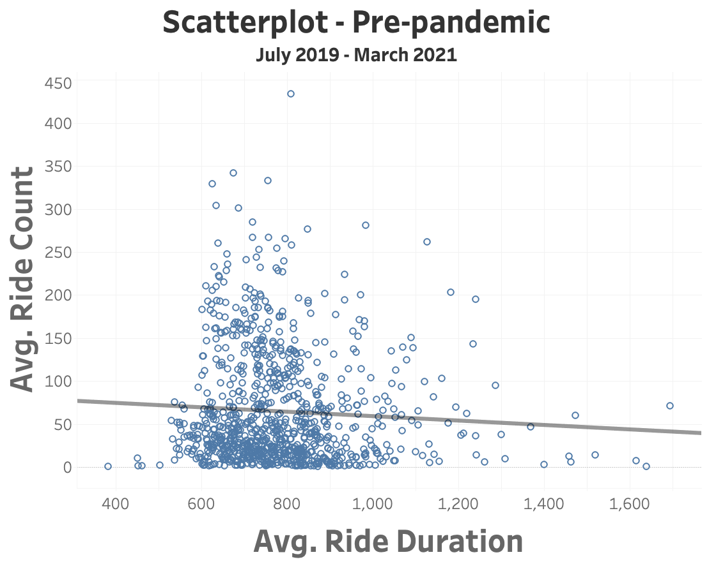
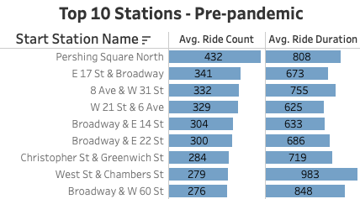
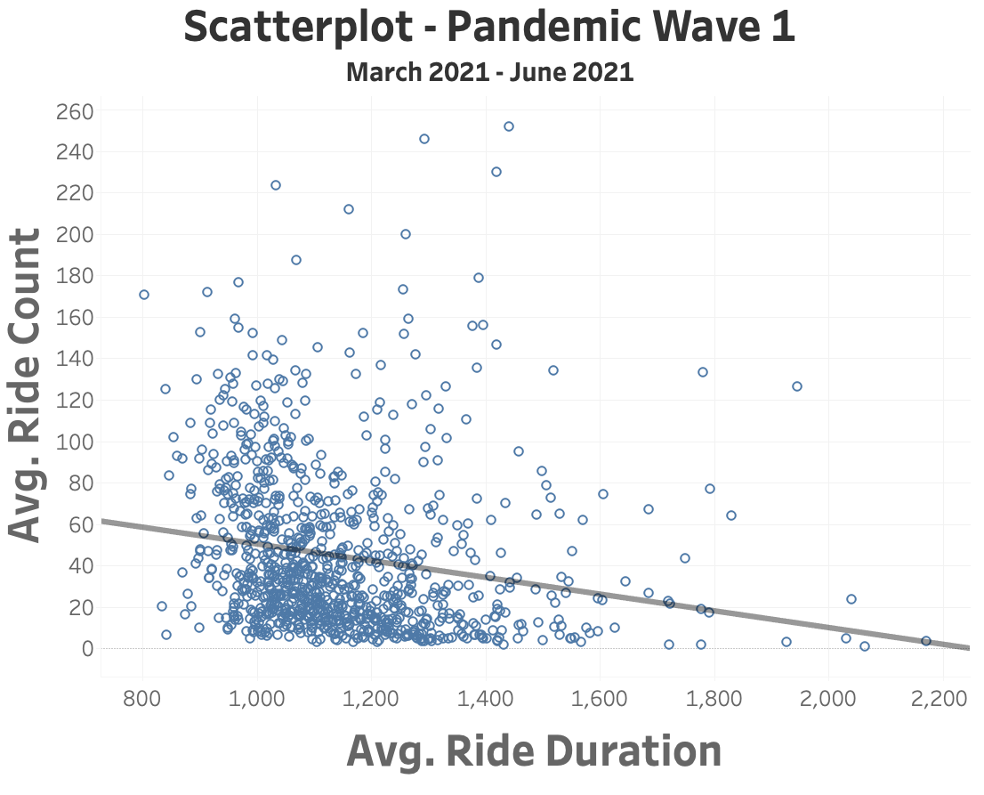
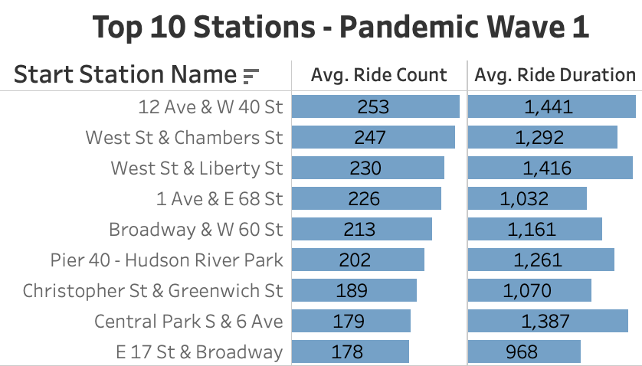
Descriptive Analysis--Things Changed
Ride Count and Duration
Popular Stations
Notes:
Thank you Tian! We used tableau to do descriptive analysis. After COVID hit, the average rides per day across all stations declined ~25%. However, the average duration increased ~25%. Also, It is more interesting that the majority of the top 10 busy stations has changed a lot. The change in popular stations is also confirmed by following output of associative rules.

Slide 13
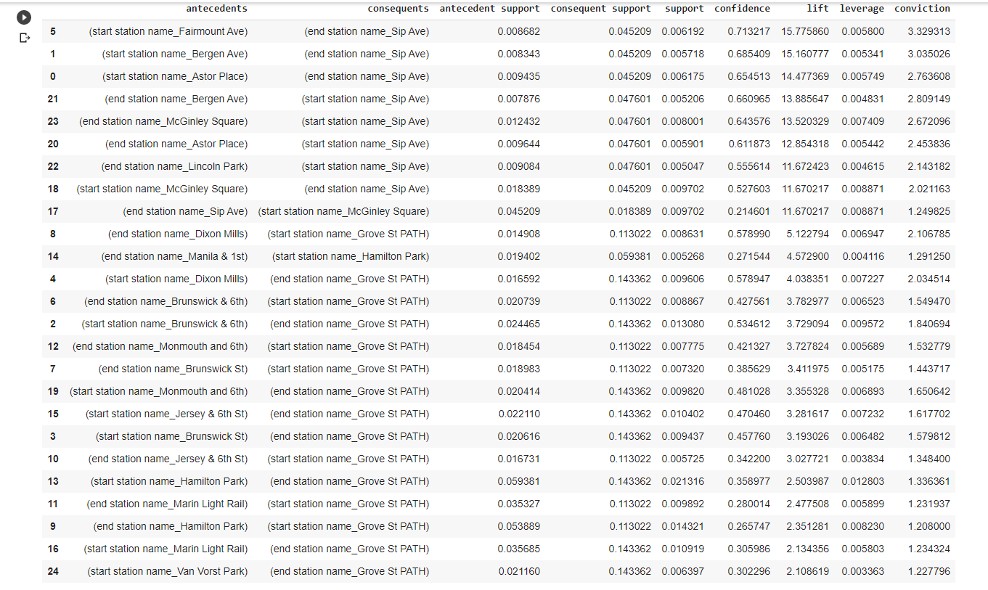
Association Rules -- Pre COVID

Slide 14
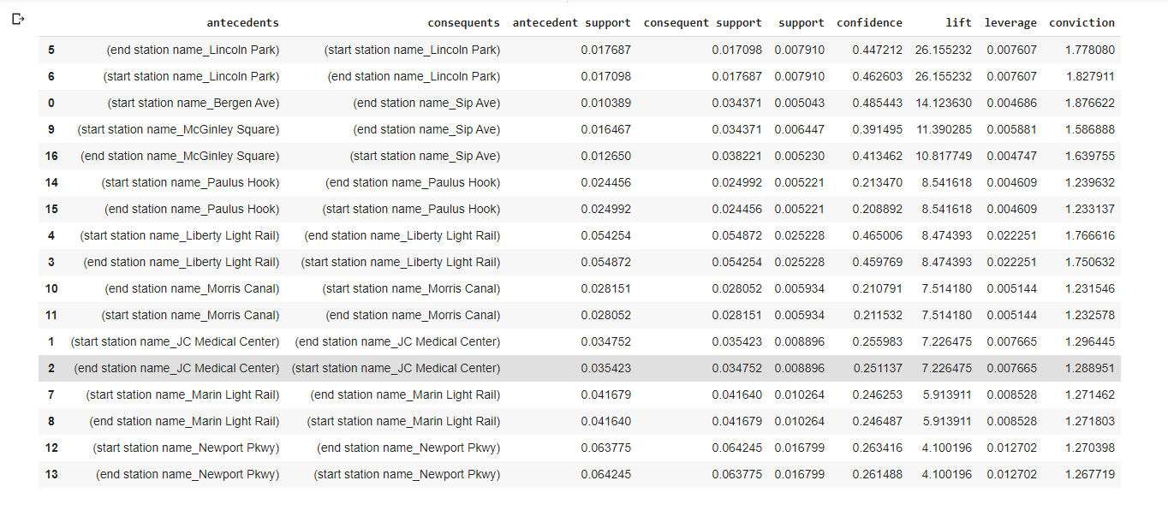
Association Rules -- Post COVID

Slide 15
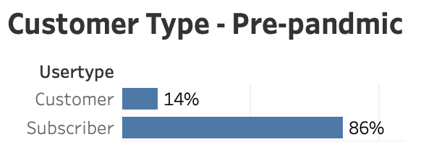
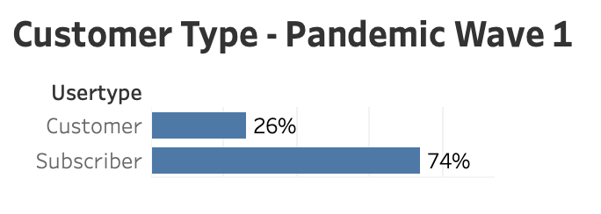
Descriptive Analysis--Things Changed
Customer Type
Notes:
There is a significant shift on customer type that number of subscribers declining from 86% to 74%. This is likely because that most subscribers are commuters, and there are less commuters as employees work from home.

Slide 16
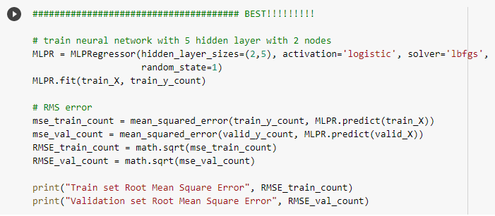
Supervised Learning -- MLP network
Notes:
We use MLP supervised learning model to predict the daily ride count and average trip duration by using moving averages, weekday, season, and COVID-19 factors as our predictors. Data in 2020 are used as training set, and data in 2021 are used as test set.
Here we evaluate the model performance by comparing the Mean Squared Error on the test set..

Slide 17
 | Ride Count |  | Avg Trip Duration
 | Train | Test | Train | Test
1 layer-2 node | 0.06979 | 0.05732 | 0.01634 | 0.12772
1 layer-5 node | 0.07118 | 0.06687 | 0.01703 | 0.12867
5 layer-2 node | 0.06880 | 0.05070 | 0.01990 | 0.12772
5 layer-5 node | 0.06866 | 0.04348 | 0.01905 | 0.12766
100 layer-2 node | 0.07676 | 0.04966 | 0.02044 | 0.12933
Notes:
As we can see from the table, we have 5 different MLP structures, and the one with 5 layers and 5 nodes has the best performance since it has the lowest error on test set. Also, the value of error is in a reasonable range to be used in future decision making.

Slide 18
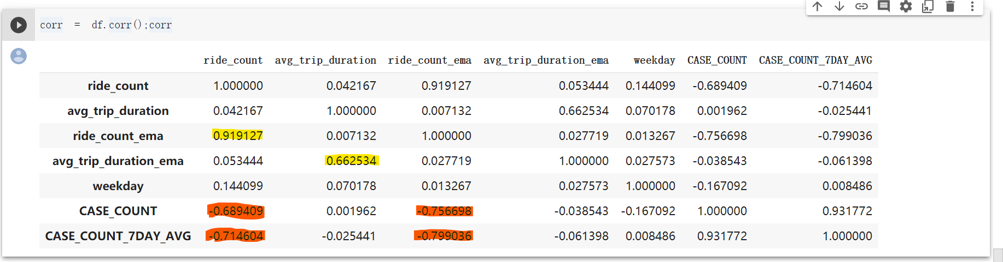
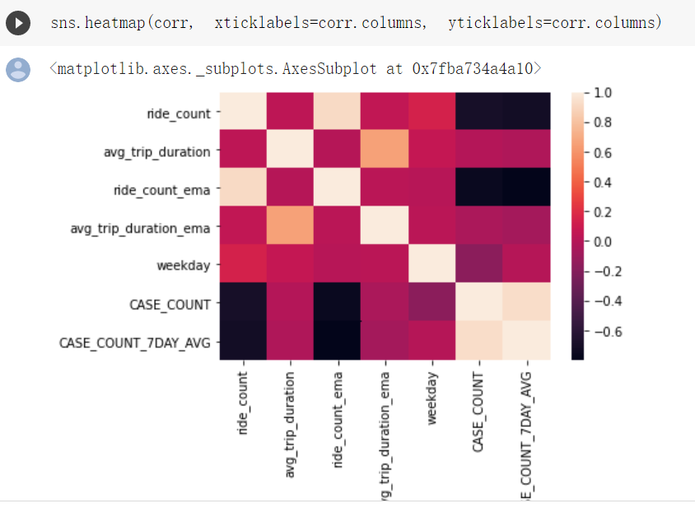
Supervised Learning -- Correlation
Notes:
Then, we want to use different machine learning models to predict the daily ride count again, and we want to know which feature plays the most important role.
Before we apply these models, we guess that the moving average of ride count, COVID-19 variables might be more important based on this correlation matrix and heatmap.

Slide 19
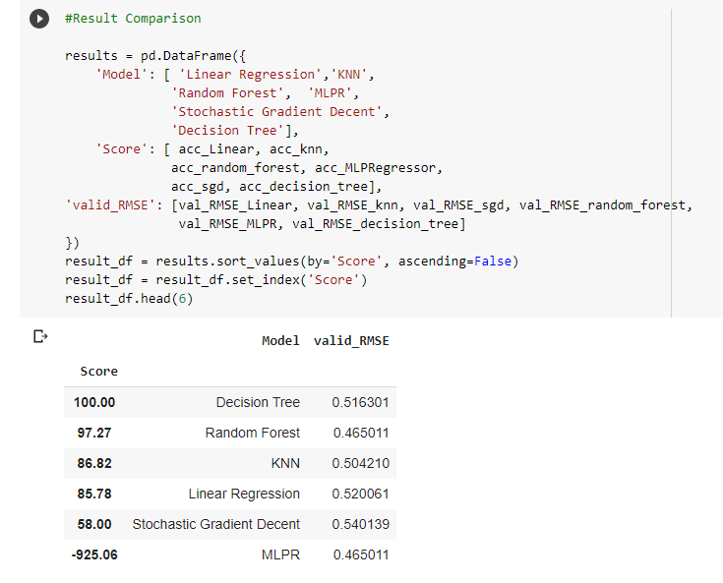
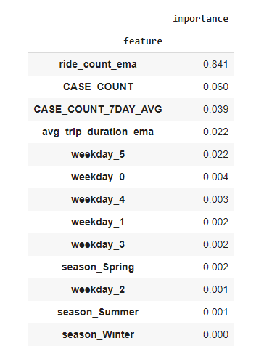
Supervised Learning -- Feature Importance
Notes:
We use linear regression, random forest, MLP, gradient descent, and decision tree as our ML models. We compare the model performance on ACC score and the RMSE on test set. We find that Random forest is more suitable here since it has higher ACC score and lower RMSE on the test set. The table of feature importance shows that COVID is the most important factor other than the moving average of ride count. However it is interesting that seasons does not really matter at all. Afterall, winter is not a good season for biking. Next, let’s move to Jordan’s part.

Slide 20
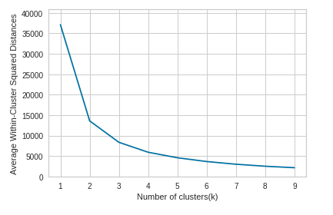
Unsupervised Learning -- Clustering
Notes:
Interested in clustering stations with ride count and avg trip distance on daily level
Data is Groupby station and date, with daily station info on its columns
Elbow method to determine clusters

Slide 21
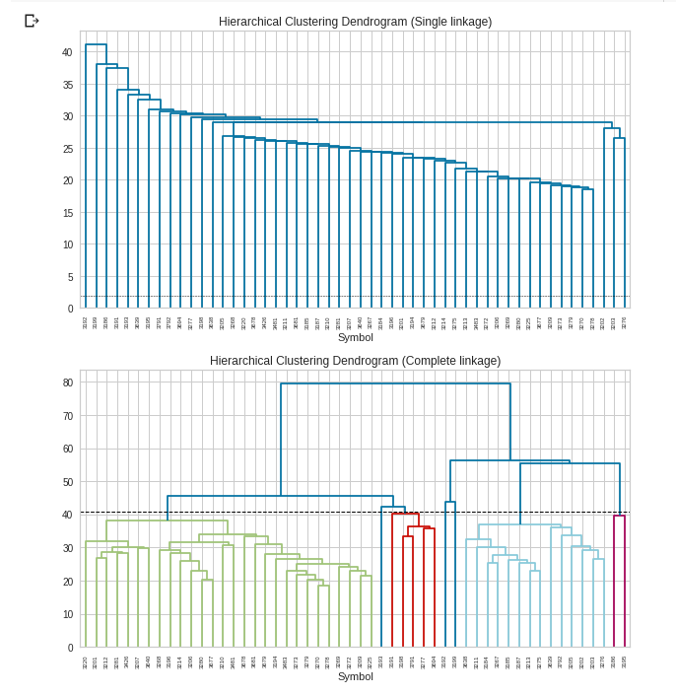
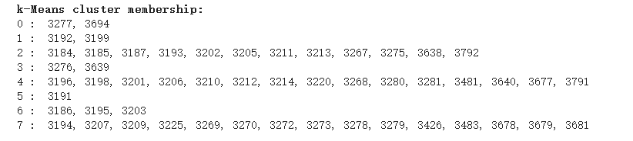
Unsupervised Learning -- Clustering
Notes:
Conduct K-means, single linkage and complete linkage. There is a difference in grouping results because there is data noice in info on daily level.

Slide 22
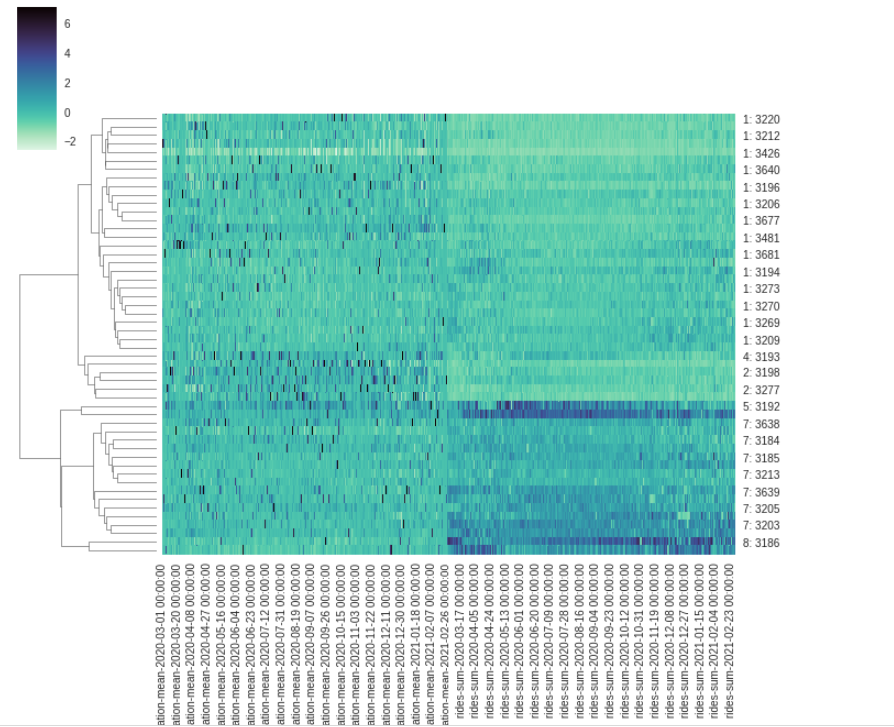
Unsupervised Learning -- Clustering
Notes:
Cluster map for station vs daily station info is plotted, group 5 and 8 are ride-count heavy stations, while group 2 and 4 are concerned with longer average trip duration.

Slide 23
05
Insights & Recommendation
……...

Slide 24
Bike Availability
Demand
Availability
Distribution
Forecast daily demand at each station
Check demand vs. availability for gaps
Effectively re-distribute bikes
Notes:
During our analysis we noticed that demand at the most popular stations has changed significantly, which could cause problems if bikes are not re-distributed accordingly.
For example, we noticed that the most popular station pre-pandemic was seeing a lot less demand during the first wave.
There is an opportunity to forecast demand for the next day at each station, and to use this information to make sure bikes are available at the right location.
In addition, since moving bikes around is costly, the redistribution process could also be optimized by finding the optimal route between the stations with surplus bikes and those with a deficit based on predicted demand levels.

Slide 25


Promotions
Fitness-pass
Buddy-pass
New membership type to convert more users to subscribers
Promo codes for friends who sign up as subscribers together
Notes:
The second recommendation involves promoting the annual pass in order to encourage more users to subscribe to the service.
During our analysis, we noticed the proportion of users that were annual subscribers declined significantly, likely due to the fact that many commuters are no longer traveling back and forth between their home and the office.
Demand for subscribers is more predictable, and they pay up front, which allows the cash to be used for further expansion of the network.
In order to boost subscribership, we are recommending two new promotions for the annual pass:
A buddy-pass that provides a discount for friends who sign up for an annual pass together.
A fitness pass that provides a reward for the riders who ride farthest distance each day.

Slide 26
06
Conclusion
……...
COVID impact on bikes
Bike distribution and avail.
Supervised, Unsupervised learning, associative rules
Derive insights
Notes:
Overall, our two areas of concerns are the impact of COVID-19 on bikes in New York City, and the distribution and availability of Bikes in its current status.
We used Supervised learning to analyze the impact of COVID-19, unsupervised learning and association rules to analyze stations that require attention.
Furthermore, a solution of having different passes to convert more customer to subscriber.

